Slide 1
Beyond Process Mining:
Discovering Business Rules From Event Logs
Marlon Dumas
University of Tartu, Estonia
With contributions from Luciano García-Bañuelos, Fabrizio Maggi & Massimiliano de Leoni
Theory Days, Saka, 2013

Slide 2

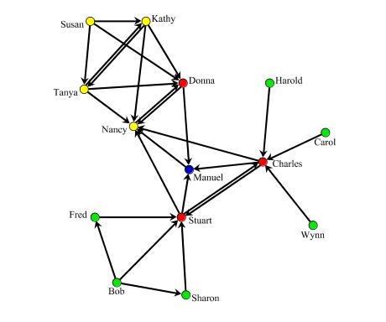

Business Process Mining
Event
Log
Organizational Model
Social Network
Process Model
Process mining tool (ProM, Disco, IBM BPI)
Performance Analysis
Slide by Ana Karla Alves de Medeiros

Slide 3
Automated Process Discovery
CID | Task | Time Stamp | Attribute1 (amount) | Attribute2 (salary)
13219 | Enter Loan Application | 2007-11-09 T 11:20:10 | … | …
13219 | Retrieve Applicant Data | 2007-11-09 T 11:22:15 | … | …
13220 | Enter Loan Application | 2007-11-09 T 11:22:40 | … | …
13219 | Compute Installments | 2007-11-09 T 11:22:45 | … | …
13219 | Notify Eligibility | 2007-11-09 T 11:23:00 | … | …
13219 | Approve Simple Application | 2007-11-09 T 11:24:30 | … | …
13220 | Compute Installements | 2007-11-09 T 11:24:35 | … | …
… | … | … | … | …
Issue 1: Data?

Slide 4
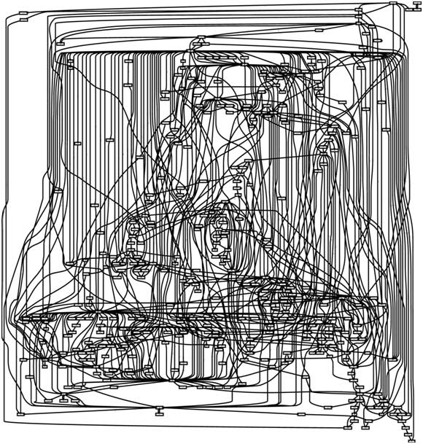
Issue 2: Complexity

Slide 5
Dealing with Complexity
Question: How to cope with complexity in (information) system specifications?
  Aggregate-Decompose
  Generalize-Specialize
  Special cases
    Summarize by aggregating and ignoring “uninteresting” parts
    Summarize by specializing and ignoring “uninteresting” specialized classes

Slide 6

Bottom-Line
Do we want models
or do we want insights?
www.interactiveinsightsgroup.com
Notes:
Discovering rules that describe not what happens but why it happens

Slide 7
Discovering Business Rules
Decision rules
Why does something happen at a given point in time?
Descriptive (temporal) rules
When and why does something happen?
Discriminative rules
When and why does something wrong happen?

Slide 8
Mining Decision Rules

Slide 9
What’s missing?
Decision
points
age
salary
amount
length
installment

Slide 10
ProM’s Decision Miner
age
salary
amount
length
installment
CID | Amount | Len | Salary | Age | Installm | Task
CID | Amount | Len | Salary | Age | Installm | Task
13219 | 8500 | 1 | NULL | NULL | NULL | ELA
CID | Amount | Len | Salary | Age | Installm | Task
13219 | 8500 | 1 | NULL | NULL | NULL | ELA
13219 | 8500 | 1 | 2000 | 25 | NULL | RAP
13219 | 8500 | 1 | 2000 | 25 | 750 | RAP
13219 | 8500 | 1 | 2000 | 25 | 750 | NE
CID | Task | Data | Time Stamp | …
13219 | ELA | Amount=8500 Len=1 | 2007-11-09 T 11:20:10 | -
13219 | RAP | Salary=2000 Age=25 | 2007-11-09 T 11:22:15 | -
13220 | ELA | Amount=25000Len=1 | 2007-11-09 T 11:22:40 | -
13219 | CI | Installm=750 | 2007-11-09 T 11:22:45 | -
13219 | NE |  | 2007-11-09 T 11:23:00 | -
13219 | ASA |  | 2007-11-09 T 11:24:30 | -
13220 | CI | Installm=1200 | 2007-11-09 T 11:24:35 | -
… | … | … | … | …

Slide 11
ProM’s Decision Miner / 2
CID | Amount | Installm | Salary | Age | Len | Task
13219 | 8500 | 750 | 2000 | 25 | 1 | ASA
13220 | 12500 | 1200 | 3500 | 35 | 4 | ACA
13221 | 9000 | 450 | 2500 | 27 | 2 | ASA
… | … | … | … | … | … | …
Decision tree
learning
(amount < 10000) ∨
(amount ≥ 10000 ∧ age < 35)
(amount < 10000)
amount
≥ 10000
< 10000
age
Approve Simple
Application (ASA)
amount ≥ 10000
∧ age ≥ 35
< 35
≥ 35
Approve Complex
Application (ACA)
Approve Simple
Application (ASA)

Slide 12
ProM’s Decision Miner – Limitations
Decision tree learning cannot discover expressions of the form “v op v”
installment > salary

Slide 13
Generalized Decision Rule Mining in Business Processes
Problem
  Discover decision rules composed of atoms of the form “v op c” and “v op v”, including linear equations or inequalities involving multiple variables
Approach
  Likely invariant discovery (Daikon)
  Decision tree learning
De Leoni et al. FASE’2013

Slide 14
Daikon: Mining Likely Invariants
CID | Amount | Installm | Salary | Age | Len | Task
13210 | 20000 | 2000 | 2000 | 25 | 1 | NR
13220 | 25000 | 1200 | 3500 | 35 | 2 | NE
13221 | 9000 | 450 | 2500 | 27 | 2 | NE
13219 | 8500 | 750 | 2000 | 25 | 1 | ASA
13220 | 25000 | 1200 | 3500 | 35 | 2 | ACA
13221 | 9000 | 450 | 2500 | 27 | 2 | ASA
… | … | … | … | … | … | …
Daikon
installment > salary
amount ≥ 5000
length < age
…
installment ≤ salary
amount ≤ 9500
length < age
…
installment ≤ salary
amount ≥ 5000
length < age
…
installment ≤ salary
amount ≥ 10000
length < age
…

Slide 15
Mining Descriptive Temporal Rules

Slide 16
Problem Statement
Given a log, discover a set of temporal rules (LTL) that characterize the underlying process, e.g.
  In a lab analysis process, every leukocyte count is eventually followed by a platelet count
    ☐(leukocyte_count → platelet_count)
  Patients who undergo surgery X do not undergo surgery Y later
    ☐(X → ☐ not Y)

Slide 17
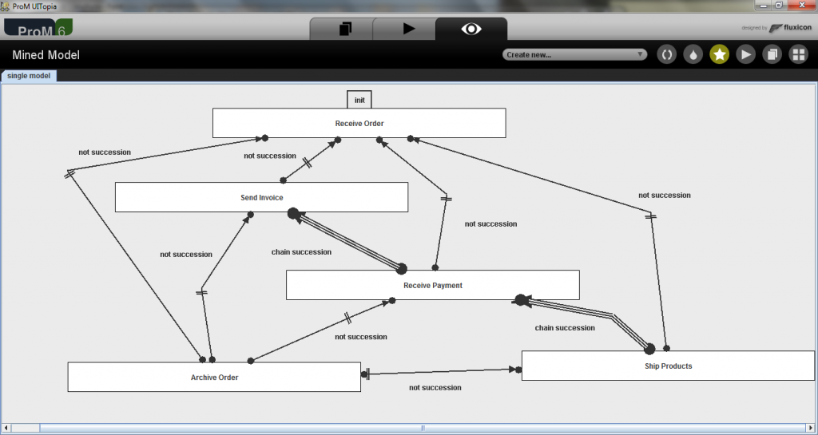
DeclareMiner
(Maggi et al. 2011)

Slide 18
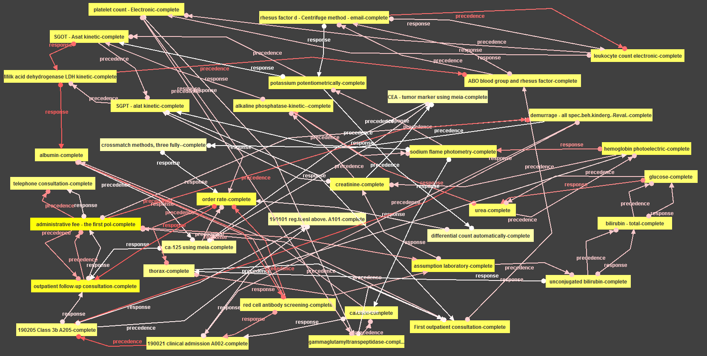
Oh no! Not again!

Slide 19
What went wrong?
Not all rules are interesting
What is “interesting”?
  Not necessarily what is frequent (expected)
  But what deviates from the expected
Example:
  Every patient who is diagnosed with condition X undergoes surgery Y
    But not if the have previously been diagnosed with condition Z

Slide 20
Interesting Rules
Something should have “normally” happened but did not happen, why?
Something should normally not have happened but it happened, why?
Something happens only when things go “well”
Something happens only when things go “wrong”

Slide 21
Discovering Refined Temporal Rules
Discover temporal rules that are frequently “activated” but not always “fulfilled”, e.g.
  When A occurs, eventually B occurs in 90% of cases
    ☐(A → B) has 90% fulfillment ratio
  Discover a rule that describes the remaining 10% of cases, e.g. using data attributes
    ☐(A [age < 70] → B) has 100% fulfillment ratio

Slide 22
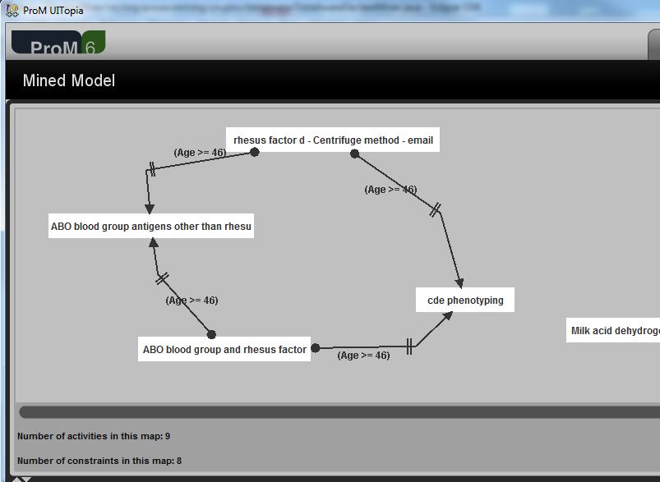
Now it’s better…
Maggi et al. BPM’2013

Slide 23
Discriminative Rules Mining

Slide 24
Problem Statement
Given a log partitioned into classes
  e.g. good vs bad cases, on-time vs late cases
Discover a set of temporal rules that distinguish one class from the other, e.g.
    Claims for house damage that end up in a complaint, are often those for which at two or more data entry errors are made by the customer when filing the claim

Slide 25
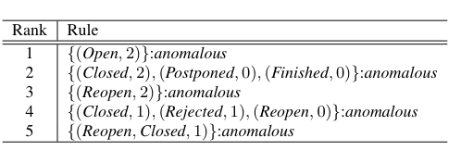
Mining Anomalous Software Development Issues (Sun et al. 2013)
Extract features from traces based on which events occur in the trace
Apply a contrasting itemset mining technique ➔ features in one class and not in the other
Decision tree to construct readable rules

Slide 26

Where is the data?

Slide 27
Challenges
Scalable algorithms for discovering FO-LTL rules
  Frequent rules (descriptive)
  Discriminative rules
  Other interestingness notions
Interactive business rule mining

