Slide 1
NP has log-space verifiers with fixed-size public quantum registers
ABUZER YAKARYILMAZ
Faculty of Computing
University of Latvia
A. C. CEM SAY
Department of Computer Engineering
Boǧaziçi University
October 07, 2011
TÕRVE

Slide 2
An interactive proof system for a language
$$x∈L?$$
PROVER
VERIFIER
probabilistic machine

Slide 3
An interactive proof system for a language
$$x∈L?$$
PROVER
VERIFIER
unlimited computational power
resource-bounded
Prover can cheat!

Slide 4
Two criteria:
Language $L$ has a proof system $(P,V)$ if
COMPLETENESS
For every $w∈L$, the verifier $V$ always accepts with high probability after interacting the prover $P$
SOUNDNESS
For every $w∉L$ and every $P^{∗}$, the verifier $V$ rejects with high probability after interacting $P^{∗}$

Slide 5
Arthur-Merlin system (space-bounded)
₵ | 0 | 1 | # | … | 0 | 1 | # | $
Input tape (read-only)
1
MERLIN
Communication
cell
ARTHUR
outcomes
… | # | 0 | 1 | # | …
… | # | 1 | 1 | # | …
Work tape (restricted)
Random number
generator
Work tape (unlimited)

Slide 6
Complexity classes
$P$ is the class of languages recognized by a deterministic Turing machine in polynomial time.
$NP$ is the class of language recognized by a nondeterministic Turing machine in polynomial time.
---
$NP$ is the class of languages having an AM proof system with no error such that
the random number generator is removed and
the runtime of Arthur is restricted with polynomial time.
Class $P$ is obtained, if the communication cell is removed as a further restriction.
---
$\text{AM}\text{(}\text{log}$-$\text{space}\text{) =} P⊆NP$ [Con89]
A well-known open problem: Is $P$ equal to $NP$, or not?

Slide 7
A new system: qAM
₵ | 0 | 1 | # | … | 0 | 1 | # | $
Input tape (read-only)
1
MERLIN
Communication
cell
ÂRTHUR
outcomes
… | # | 0 | 1 | # | …
… | # | 1 | 1 | # | …
Work tape (restricted)
A finite quantum
register
Work tape (unlimited)

Slide 8
The finite quantum register
A quantum register is an $n$-dimensional Hilbert space, $ℋ_{n}$, with basis
$𝔅=\left\{\left|q_{1}\right\rangle , | q_{2}\right\rangle ,…,|q_{n}⟩\}$, where
$\left|q_{1}\right\rangle =\left(\begin{aligned}1 \\ 0 \\ 0 \\ \begin{matrix}⋮ \\ 0\end{matrix}\end{aligned}\right),\left|q_{2}\right\rangle =\left(\begin{aligned}0 \\ 1 \\ 0 \\ \begin{matrix}⋮ \\ 0\end{matrix}\end{aligned}\right),…,\left|q_{n}\right\rangle =\left(\begin{matrix}0 \\ 0 \\ \begin{matrix}⋮ \\ 0 \\ 1\end{matrix}\end{matrix}\right)$
A quantum state is a linear combination of basis states, i.e.
$\left|ψ\right\rangle =\sum_{i=1}^{n}{α_{i}|q_{i}⟩}, \sum_{i=1}^{n}{{\left|α_{i}\right|}^{2}=1}$, where
each $α_{i}∈ℂ$ is called the amplitude of being state $\left|q_{i}\right\rangle$ and the probability of being in state $\left|q_{i}\right\rangle$ is given by ${\left|α_{i}\right|}^{2}$.

Slide 9
The operations on the register
Initializing the register (a predefined quantum state)
Applying a superoperator $ε=\{E_{1},…,E_{k}\}$ ($k>0$) satisfying
$\sum_{i=1}^{k}{E_{i}^{†}E_{i}}=I$,
where
$E_{i}$ is an operation element
$i$ is the measurement outcome
[Optional] Each entry of $E_{i}$ is a rational number
$$\frac{\left|\tilde{ψ_{1}}\right\rangle }{\sqrt{p_{1}}}$$
$\left|\tilde{ψ_{1}}\right\rangle$= $E_{1}|ψ⟩$
$$p_{1}=\tilde{{⟨ψ}_{1}}|\tilde{ψ_{1}}⟩$$
$$\frac{\left|\tilde{ψ_{2}}\right\rangle }{\sqrt{p_{2}}}$$
$$p_{2}=\tilde{{⟨ψ}_{2}}|\tilde{ψ_{2}}⟩$$
$\left|\tilde{ψ_{2}}\right\rangle$= $E_{2}|ψ⟩$
…
…
$$ε(|ψ⟩)$$
…
$$p_{k}=\tilde{{⟨ψ}_{k}}|\tilde{ψ_{k}}⟩$$
…
$\left|\tilde{ψ_{k}}\right\rangle$= $E_{k}|ψ⟩$
$$\frac{\left|\tilde{ψ_{k}}\right\rangle }{\sqrt{p_{k}}}$$

Slide 10
$SUBSET$-$SUM$ $∈$ $qAM(const$-$space)$
$\text{S}\text{UBSET}$-$\text{SUM}$, a well-known $NP$-complete problem, is the collection of all strings of the form
$$S\#a_{1}\#a_{2}\#⋅⋅⋅\#a_{n}\#$$
such that $n>0$, $S$ and $a_{i}$’s are numbers in binary $(1≤i≤n)$, and there exists a set $I⊆\{1,…, n\}$ satisfying $\sum_{i∈I}{a_{i}=S}$.
---
Ârthur can encode binary numbers into amplitudes of the states of the register and can also make addition and subtraction on them.
The strategy of Ârthur:
Ârthur requests the set $I$ from Merlin and then tests
$\sum_{i∈I}{a_{i}=S}$.

Slide 11
Some details of the algorithm
₵ | 0 | 1 | … | 1 | # | 1 | 0 | … | 1 | # | … … | 1 | 1 | … | 0 | # | $
… …
$$S$$
$$a_{1}$$
$$a_{n}$$
Before reading $
Initial state
$$\left|\tilde{ψ_{\left|w\right|}}\right\rangle ={\left(\frac{1}{3}\right)}^{\left|w\right|}\left(\begin{aligned}1 \\ S \\ 0 \\ T\end{aligned}\right)$$
auxiliary value
$$\left(\begin{aligned}1 \\ 0 \\ 0 \\ 0\end{aligned}\right)$$
to store $S$
to store $a_{i}$’s
$$\underbrace{{\left(\frac{1}{3}\right)}^{\left|w\right|+1}}$$
to store $\sum_{i∈I}{a_{i}}$
$$\underbrace{{\left(\frac{1}{3}\right)}^{\left|w\right|+1}2(S−T) }$$
Accept ($=Acc$)
reject
Member are accepted exactly.
Nonmembers are rejected with a probability at least $\frac{4}{5}$.
The error gap can be reduced to any desired value by using
conventional probability amplification techniques.
$$=0 \left(S=T\right)$$
$$≥4⋅Acc (S≠T)$$

Slide 12
$NP⊆qAM(log$-$space)$
Any language in $NP$ is log-space reducible to $SUBSET$-$SUM$ [Pap94]:
Let $L$ be language in $NP$, then there exists a logarithmic space deterministic algorithm $D$ that outputs $u=f(w)$ for any given input string $w$ such that
$w∈L \text{if} \text{and} \text{only} \text{if} u∈SUBSET$-$SUM$.
---
For any given input string $w$, Ârthur can run the algorithm for $SUBSET$-$SUM$ on ${u=u}_{1}u_{2}⋯u_{\left|u\right|}$.
$∴L∈qAM(log$-$space)$.
$AM(log\text{-}space)=P⊆NP⊆qAM(log$-$space)$

Slide 13
Concluding remarks
A poly-time Ârthur can be simulated by a poly-time Arthur:
$AM(poly$-$time)=qAM(poly$-$time)$
In constant space [DS92,CHPW94,AW02]:
$AM(const$-$space)⊊$ $qAM(const$-$space)$
$AM(const$-$space,poly$-$time)⊊qAM(\text{const}$-$space,poly$-$time)$
(if arbitrary transition amplitudes are allowed)
Is $P⊆AM(log$-$space,poly$-$time)$? [Con93]
What is the relationship between
$P$ and $qAM(log$-$space,poly$-$time)$?

Slide 14
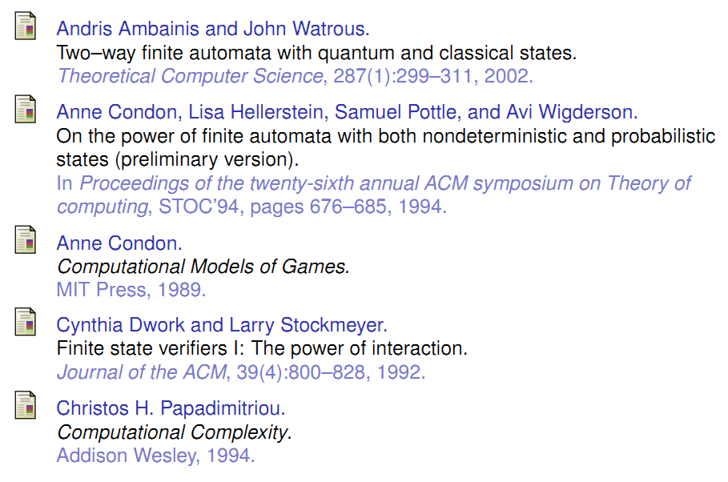
References

