Slide 2
Boolean Satisfiability (SAT) Problems
Given a propositional Boolean formula φ
(a ∨ b) ∧ (a → b) ∧ (a ← b) ∧ ¬ (a ∧ b)
determine whether a satisfying assignment of variables to
truth values exists.
Result is a claim:
SAT: at least one satisfying assignment exists
UNSAT: no satisfying assignment exists
Back-end language for many applications:
Hardware verification • Software verification
System configuration • Genome analysis
...

Slide 3
Boolean Satisfiability Solving
Given a propositional Boolean formula φ in clausal form
{{a, b}, {¬a, b}, {a,¬b}, {¬a,¬b}}
determine whether a satisfying assignment of variables to
truth values exists.
Solvers based on Davis-Putnam-Logemann-Loveland algorithm:
If φ = ∅ then SAT
If ⃞ ∈ φ then UNSAT
If φ = φ’ ∪ {x} then DPLL(φ’[x ↦ true]) If φ = φ’ ∪ {¬x} then DPLL(φ’[x ↦ false])
Pick arbitrary x and return DPLL(φ[x ↦ false]) ∨ DPLL(φ[x ↦ true])
NP-complete but many heuristics and optimizations
can handle problems with 100,000’s of variables
{{a, b}, {¬a, b}, {a,¬b}}
a ↦ false
a ↦ true
{{b}, {¬b}}
{{b}}
b ↦ false
b ↦ true
b ↦ true
{⃞}
{⃞}
∅

Slide 4
Boolean Satisfiability Solving
Given a propositional Boolean formula φ in clausal form
{{a, b}, {¬a, b}, {a,¬b}, {¬a,¬b}}
determine whether a satisfying assignment of variables to
truth values exists.
Solvers based on Davis-Putnam-Logemann-Loveland algorithm:
If φ = ∅ then SAT
If ⃞ ∈ φ then UNSAT
If φ = φ’ ∪ {x} then DPLL(φ’[x ↦ true]) If φ = φ’ ∪ {¬x} then DPLL(φ’[x ↦ false])
Pick arbitrary x and return DPLL(φ[x ↦ false]) ∨ DPLL(φ[x ↦ true])
NP-complete but many heuristics and optimizations
can handle problems with 100,000’s of variables
Result is a claim:
SAT: at least one satisfying assignment exists
UNSAT: no satisfying assignment exists
Do you trust your SAT-solver?
{{a, b}, {¬a, b}, {a,¬b},{¬a,¬b}}
a ↦ false
a ↦ true
{{b}, {¬b}}
{{b} ,{¬b}}
b ↦ false
b ↦ true
{⃞}
{⃞}
{⃞}
{⃞}

Slide 5
Certificates provide assurance for untrusted systems.
Def.: A certificate is externally checkable evidence of the validity of a claim.
valid certificate guarantees correctness of specific run only
but even for incorrect systems

Slide 6
Certificates for SAT Claims
Def.: A certificate is externally checkable evidence of the validity of a claim.
SAT-certificate: satisfying assignment
provided by almost all SAT-solvers
easy to check: evaluate formula wrt. assignment

Slide 7
Certificates for SAT & UNSAT Claims
Def.: A certificate is externally checkable evidence of the validity of a claim.
SAT-certificate: satisfying assignment
provided by almost all SAT-solvers
easy to check: evaluate formula wrt. assignment
UNSAT-certificate: checkable evidence of exhaustive search??

Slide 8
Certificates for SAT & UNSAT Claims
Def.: A certificate is externally checkable evidence of the validity of a claim.
SAT-certificate: satisfying assignment
provided by almost all SAT-solvers
easy to check: evaluate formula wrt. assignment
UNSAT-certificate: propositional resolution proof
provided by many SAT-solvers
can be reconstructed from DPLL search
(more) difficult to check: need to replay resolution steps
Do you trust your proof checker?

Slide 9
SHRUTI: Goal and Architecture
checkers simpler than solvers,
so formal verification is feasible
Goal: extend off-the-shelf SAT-solver by verified proof checker but not compromise industrial-strength performance
Goal: prevent system lock-in but fix proof format (tracecheck)
box up solver and proof transformation if necessary
Picosat + tracecheck clause reordering
zChaff + transformation to tracecheck format
... but can’t assign blame to solver or transformation
Industrial Strength Certified Solver
SAT Solver
industrial-strength
large & complex
untrusted (ad-hoc)
proof-generating
proof transformation
claim
SHRUTI
small & clean
trusted (formal)
proof checking
certified
claim
CNF
certificate
rejected claim
(proof)
checked
proof

Slide 10
Proof format is integer-based.
Example proof: 1 2 0 -1 2 0 1 -2 0 -1 -2 0 0 * 3 1 0 * 4 2 5 0
clauses
resolution chains
integers are variables
zero is delimiter
sign determines polarity
integers are clause indexes
zero is delimiter
‘*’ is placeholder for resolvent
must be ordered correctly
1: | 1 | 2 |  |  | {a, b}
2: | -1 | 2 |  |  | {¬a, b}
3: | 1 | -2 |  |  | {a, ¬b}
4: | -1 | -2 |  |  | {¬a,¬b}
5: | * | 3 | 1 |  | {a}
6: | * | 4 | 2 |  | {¬a}

Slide 11
Proof format is integer-based.
Example proof: 1 2 0 -1 2 0 1 -2 0 -1 -2 0 0 * 3 1 0 * 4 2 5 0
clauses
resolution chains
integers are variables
zero is delimiter
sign determines polarity
integers are clause indexes
zero is delimiter
‘*’ is placeholder for resolvent
must be ordered correctly
1: | 1 | 2 |  |  | {a, b}
2: | -1 | 2 |  |  | {¬a, b}
3: | 1 | -2 |  |  | {a, ¬b}
4: | -1 | -2 |  |  | {¬a,¬b}
5: | * | 3 | 1 |  | {a}
6: | * | 4 | 2 | 5 | ⃞
Things that can go wrong:
clauses not in problem
wrong indices in chain
wrong ordering in chain
wrong literals resolved
last resolvent is not empty clause

Slide 12
SHRUTI: Approach and Design
Idea: use extraction from formalized development (Coq)
formalize theory and algorithm (LCF style)
prove correctness properties
extract code
checker is never run inside prover
Shallow embedding, but close to actual data structures
clauses are integer lists (sorted by abs. value), not booleans
simplifies integration: not much to do on parsing
simplifies optimization of extracted code
Not dogmatic about correct-by-construction
not verifying everything (e.g. I/O) but focus on crucial core

Slide 13
SHRUTI: Formalization in Coq
Definition c1 ⋈ c2 = union c1 c2 nil
Definition union (c1 c2 : list Z) (acc : list Z) = match c1, c2 with
| nil, c2 ⇒ app (rev acc) c2
| c1, nil ⇒ app (rev acc) c1
| x::xs, y::ys ⇒ if (x+y = 0) then auxunion xs ys acc
else if (abs x < abs y) then union xs (y::ys) (x::acc)
else if (abs y < abs x) then union (x::xs) ys (y::acc)
else union xs ys (x::acc)
end
Definition auxunion (c1 c2 : list Z) (acc : list Z) = match c1, c2 with
…
| x::xs, y::ys ⇒ if (abs x < abs y) then auxunion xs (y::ys) (x::acc)
else if (abs y < abs x ) then auxunion (x::xs) ys (y::acc)
else if x=y then auxunion xs ys (x::acc)
else auxunion xs ys (x::y::acc)
end
first pair of complementary literals
copy rest
remove both
keep lists sorted
factoring
keep lists sorted
another pair of complementary literals...
keep both
factoring

Slide 14
SHRUTI: Logical characterization
“Soundness theorem”: ∀ c c c · {c , c } ⊢ c ⇒ {c , c } ⊧ c
≡ {definition ⊢ , deduction theorem}
∀ c c c · c ⋈ c = c ⇒ (c ∧ c ⇒ c )
≡ {substitution, contrapositive}
∀ c c · ¬ (c ⋈ c ) ⇒ ¬ (c ∧ c )
⇒ need to lift to integer-representation and explicit interpretations
Theorem:
∀ c c · ∀ I · Logical I ⊃
¬(EvalClause (c ⋈ c ) I) ⊃ ¬(EvalCNF [c , c ] I)
1
2
3
1
2
⋈
3
1
2
3
⋈
1
2
3
1
2
3
1
2
3
Logical I ≡ ∀ x : Z · I(-x) = ¬I(x)
1
2
1
2
1
2
EvalCNF nil I ≡ true
EvalCNF (x::xs) I ≡ EvalClause x I ∧ Eval CNF xs I
1
2
1
2
1
2
EvalClause nil I ≡ false
EvalClause (x::xs) I ≡ (I x) ∨ EvalClause xs I

Slide 15
SHRUTI: Operational characterization
Resolution can also be characterized operationally [Robinson65]:
A pair of complementary literals is deleted in the resolvent obtained from resolving a given pair of clauses.
All unequal literals that are not part of a complementary pair are retained in the resolvent.
If there are no duplicate literals within each clause, then for a literal that exists in both the clauses, only one copy of the literal is retained in the resolvent (factoring).
legality check, clause table lookup, ...
can all be formalized and proven
Only holds if there’s only one complementary pair!
This is the technical core of the work but tedious...

Slide 16
Program Extraction
Can use program extraction to convert formal development into executable OCaml code
... but hopelessly inefficient
Need to map algebraic data types to built-ins:
Z ↦ int, Boolean ↦ bool
Coq products / lists / maps ↦ OCaml records / lists / maps
7x – 10x speed-up

Slide 17
Program Extraction and Optimization
Can use program extraction to convert formal development into executable OCaml code
... but hopelessly inefficient
Need to map algebraic data types to built-ins:
Z ↦ int, Boolean ↦ bool
Coq products / lists / maps ↦ OCaml records / lists / maps
Things that should have been done by the compiler:
inlining / let-restructuring
replace app (rev x) y by tail recursive app_rev
Tweaking the garbage collector
7x – 10x speed-up
20% speed-up
10x speed-up on large problems

Slide 18
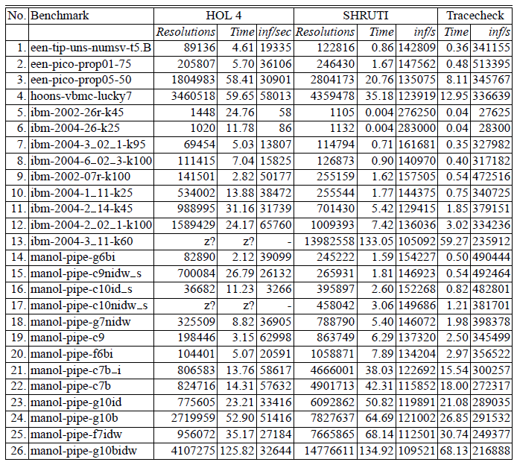
Experimental Results
industrial benchmarks
uncertified C++ proof checker
similar approach
but runs inside HOL4 prover
checks zChaff proofs
check PicoSAT proofs

Slide 19
Experimental Results - Summary
Proof checking can be fast but impacts proof times noticeably
tracecheck adds ≈10-20% to PicoSAT
Running checker inside a prover is prohibitively slow
Extraction from formal development hits sweet spot:
1.5x to 32x faster than HOL4
2.5x slower than tracecheck

Slide 20
Conclusions and Future Work
Formal verification of an efficient proof checker is feasible
... but development effort remains high
... despite focus on critical core
trusted component base: Coq core, Coq extractor, mappings, I/O, glue code, compiler, operating system
Combination of unverified solver and verified checker is an appealing approach
Formal development available at http://www.darbari.org/ashish/research/shruti/
Future work:
More optimizations
Translators for / adaption to other proof formats
SMT proofs

Slide 21
SHRUTI: Operational characterization
Resolution can also be characterized operationally [Robinson65]:
A pair of complementary literals is deleted in the resolvent obtained from resolving a given pair of clauses.
All unequal literals that are not part of a complementary pair are retained in the resolvent.
If there are no duplicate literals within each clause, then for a literal that exists in both the clauses, only one copy of the literal is retained in the resolvent (factoring).
legality check, clause table lookup, ...
can all be formalized and proven, read the paper
This is the technical core of the work but tedious...

Slide 22
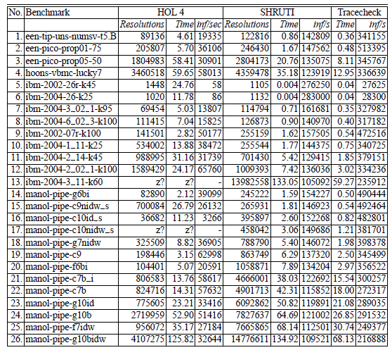
Experimental Results
industrial benchmarks
uncertified C++ proof checker
similar approach
but runs inside HOL4 prover
checks zChaff proofs
check PicoSAT proofs

